Slide 1
Maricopa County: Leveraging Forensic Genetic Genealogy to Solve Cold Cases
Detective Ashley Nolan Cesar Tirado
Chandler Police Department Maricopa County Attorney’s Office

Slide 2
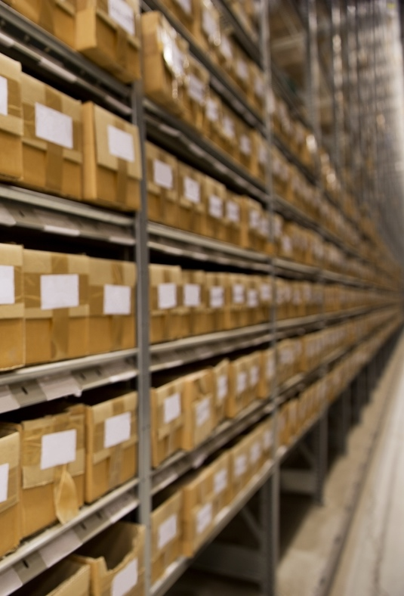
This project was supported by Grant No. 2017-AK-BX-0027 awarded by the Bureau of Justice Assistance. The Bureau of Justice Assistance is a component of the U.S. Department of Justice's Office of Justice Programs, which also includes the Bureau of Justice Statistics, the National Institute of Justice, the Office of Juvenile Justice and Delinquency Prevention, the Office for Victims of Crime, and the SMART Office. Points of view or opinions in this document are those of the author and do not necessarily represent the official position or policies of the U.S. Department of Justice.

Slide 3
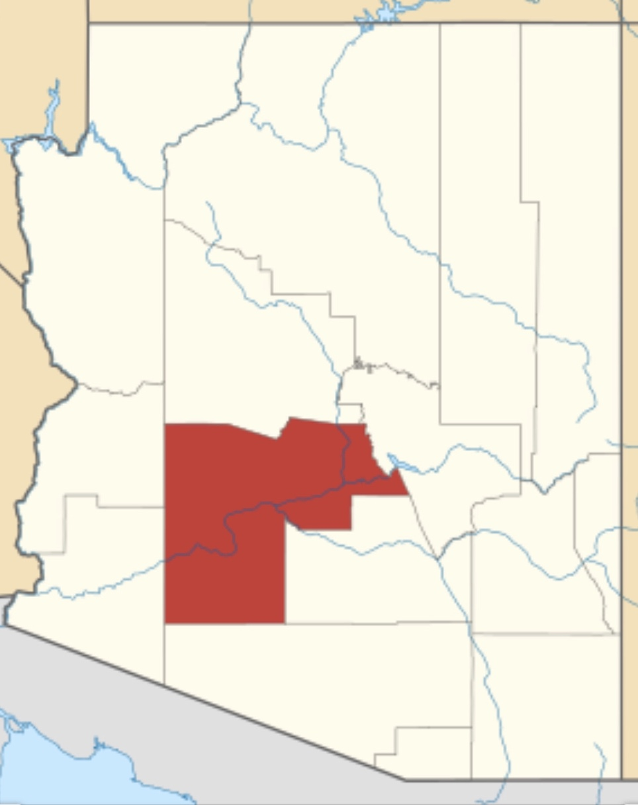
Maricopa County Attorney’s Office
South-Centrally located in Arizona
Population: Approximately 4.5 million
4th Largest County in U.S.
25 Police Agencies
4 Public Labs (DPS, Phoenix, Mesa, and Scottsdale)

Slide 4
Maricopa County Attorney’s Office
2015 – DANY ($1.9 million)
2016 – SAKI 1 ($1.2 million)
2017 – SAKI 2 ($1.2 million)
2018 – SAKI 3 ($1.5 million)

Slide 5
Maricopa County Attorney’s Office
MCAO SAKI TEAM
Director
Coordinator
3 Detectives
Crime Analyst
Part-Time Prosecutor
Part-Time Advocate

Slide 6
Maricopa County Attorney’s Office
Goals
Test the Backlog
Provide Support and Resources to our Law Enforcement Partners
Training
Investigative Support
Investigative Travel Funds
Advanced/Additional DNA testing
Assistance Extended to Other Cold-Case Sexual Assault Cases
Notes:
Provide status of the backlog.

Slide 7
Maricopa County Attorney’s Office
Procurement Process
We wanted to provide options to our law enforcement partners and allow them to choose a vendor based on the needs of their case
Contracted with 5 vendors
Challenges
Drafting the solicitation for various services (genealogy is relatively new)
LONG PROCESS!!

Slide 8
Maricopa County Attorney’s Office
Process to Request the Use of MCAO Funds for Advanced/Additional DNA Testing
Email request to come from case agent to SAKI Coordinator to include the following:
DR #
Summary of the facts of the case
List of items tested and results
List of items that were not tested
Name of vendor they want to use and the type of testing
Case agent name and contact info
We ask that you staff your case with their designated laboratory official to make sure that they agree with their request.
If we need additional information, we reach out to the case agent directly.
All requests are reviewed and receive final approval from our SAKI Director and Deputy Chief, Criminal.

Slide 9
Maricopa County Attorney’s Office
For Genetic Genealogy Requests
We ask for them to verify if unknown DNA profile is in CODIS and no hits to known offenders have been reported to date.
To confirm that there is at least 1 nanogram of DNA remaining.
Adhere to the United States Department of Justice Interim Policy Forensic Genealogical DNA Analysis and Searching (https://www.justice.gov/olp/page/file/1204386/download)

Slide 10
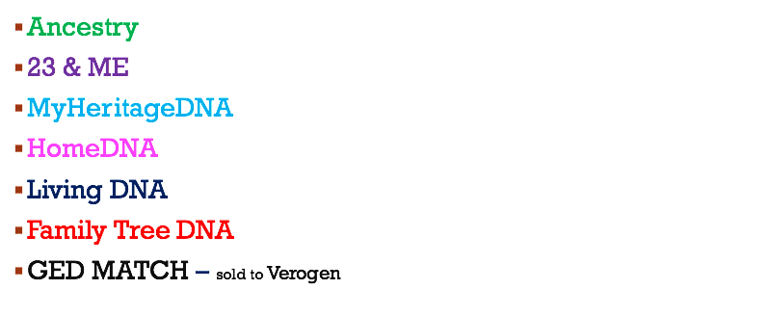
Discovering Your Ancestry

Slide 11
What is Tested?

Slide 12
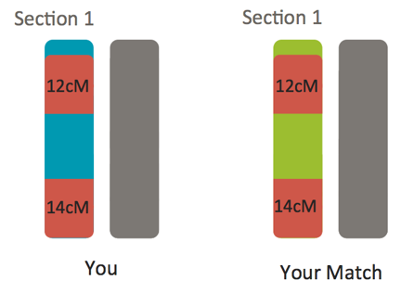
CentiMorgans

Slide 13
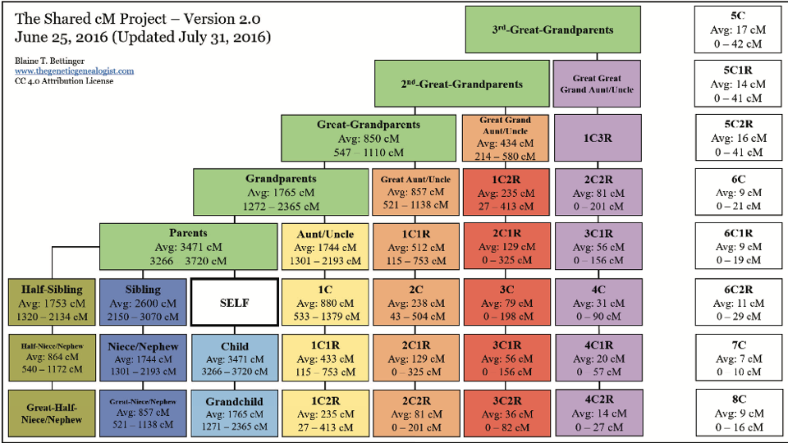

Slide 14
Grant Funding for Genetic Genealogy Testing
Review Case file
Victim status/notification
Statute of limitations
All leads exhausted

Slide 15
Tangible DNA Evidence
What is the source of your DNA?
Single source profile
Mixed profile
Degraded profiles
This may determine a particular lab to conduct the testing.

Slide 16
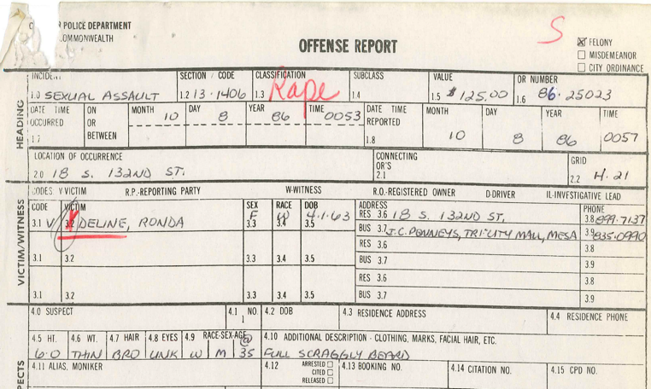
1986 – 25023 “Rape”

Slide 17
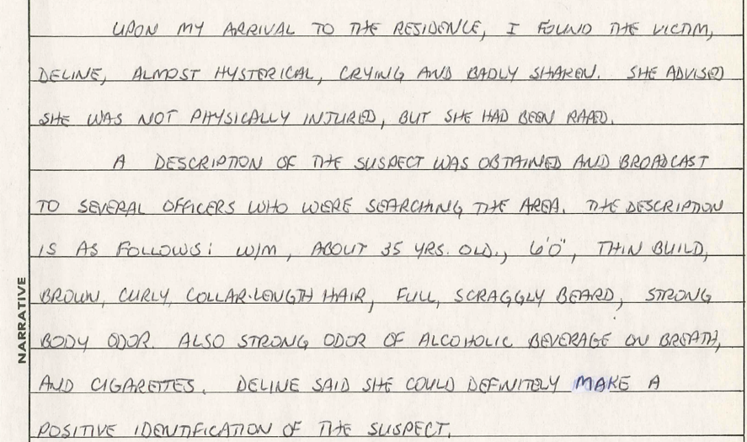

Slide 18
Case Summary Submittal
Grant Funding Approval Process

Slide 19
1986 Incident Summary:
On Wednesday, October 8th, 1986, at approximately 0057 hours, an adult female victim contacted 9-1-1 to report that she was just sexually assaulted by an unidentified individual while home alone in Chandler. The unknown perpetrator gained entry into her residence, through the master bathroom sliding window where he proceeded to forcefully have penile vaginal sexual intercourse with her. The victim participated in a medical exam which resulted in a SCEK. This kit was submitted for testing which produced an unknown male profile which was later uploaded to CODIS with negative results. In October 2019, the DNA was re-extracted by the DPS Crime Lab and submitted by Chandler PD to Gene by Gene for further genealogy testing. The results were then uploaded to Family Tree DNA and then subsequently GEDmatch. Both of which produced relationship matches to the perpetrator. At this time, CPD would like to request to utilize SAKI funds for further genealogy services with the company known as Identifinders. The intent is to use SAKI funds to cover the costs associated with Identifinders utilizing the genealogical relationship matches to identify the offender in this case.

Slide 20
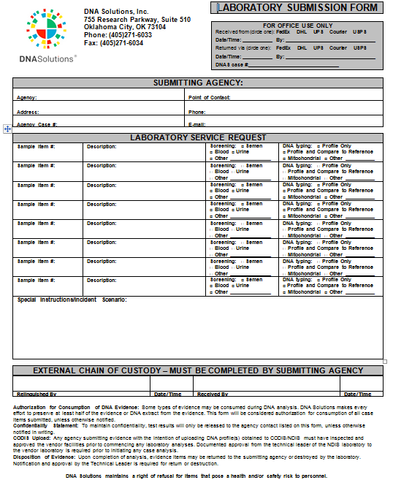
Next Step: Choose a Lab for Forensic Genetic Genealogy
-Work with lab to complete pre-submittal form(s)
-Labs will use DNA profile to make a SNP profile – compatible to upload to Genealogy sites.

Slide 21
Monitor Genealogical Process
Evidence – Chain of custody
Upload to Genealogy sites
Relationship matches

Slide 22
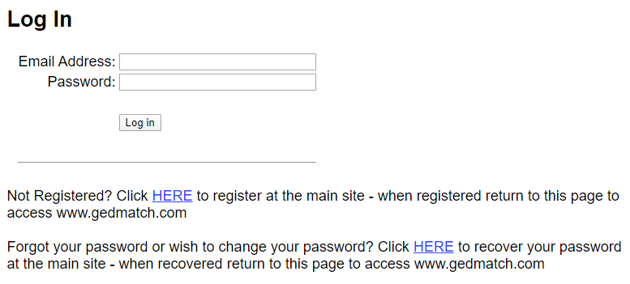
L.E. Friendly Genealogy Sites
Family Tree DNA – 750,000 users
GEDmatch – 200,000 – 2million users

Slide 23
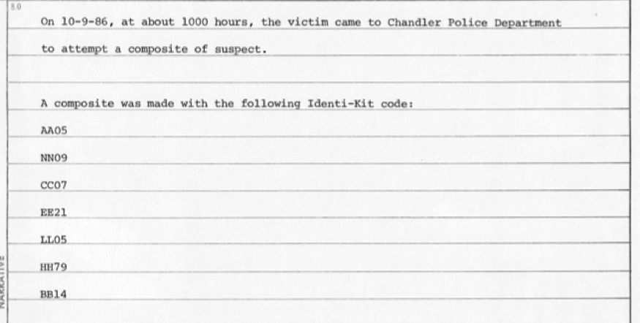
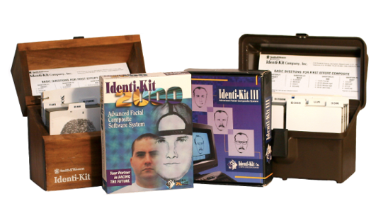
In the meantime…..

Slide 24
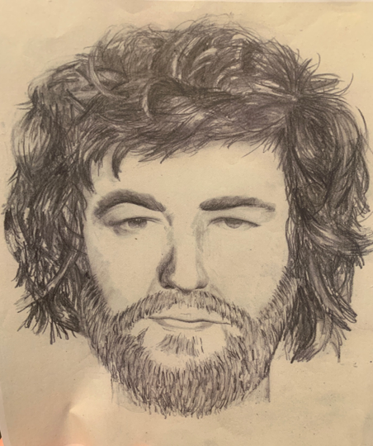
Composite Sketch
Re-created in 2019

Slide 25
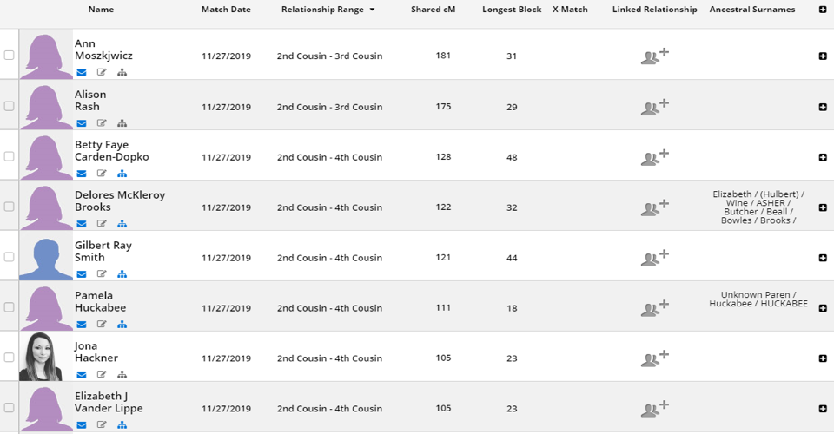
FTDNA
Results

Slide 26
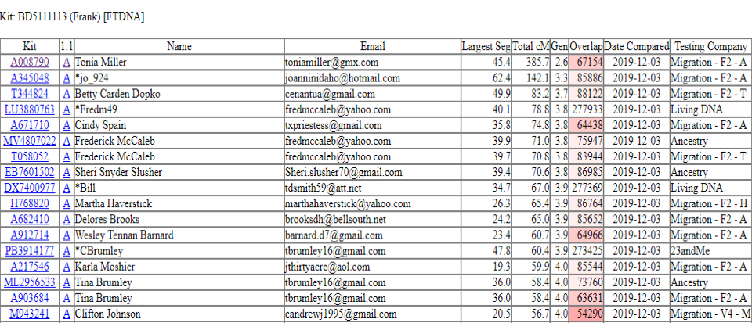
GEDmatch
Results

Slide 27
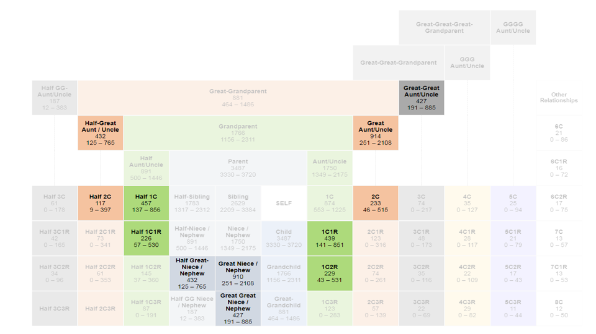

Slide 28
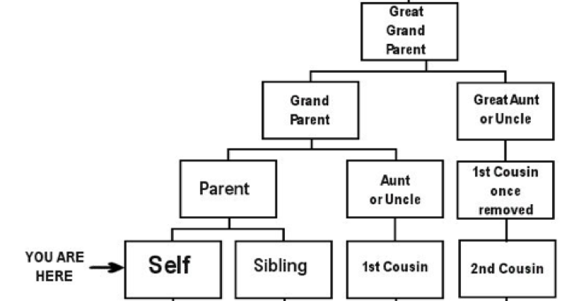

Slide 29
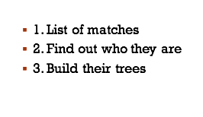
Genetic Genealogy vendor will use results to build a family tree.

Slide 30
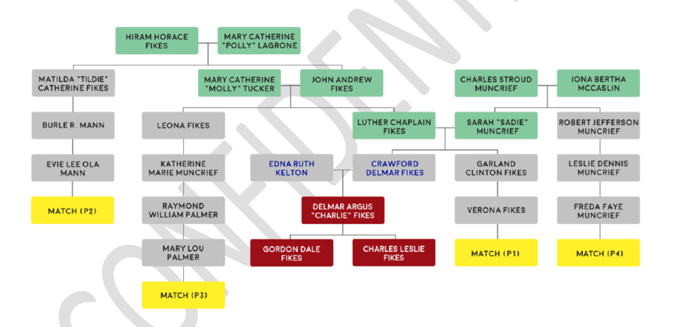
Results

Slide 31
3 crucial elements for a Genetic Genealogy cold case
DNA
Genealogy match – DNA confirmation (Surreptitious Sample)
Geographical Location
Present in jurisdiction during the date and time of the crime
Historical Information (Interviews)
Family, friends and witness statements regarding suspect

Slide 32
3 Potential Perps

Slide 33
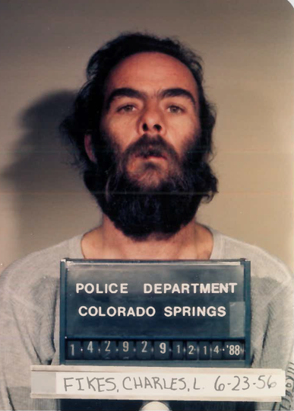

Slide 34
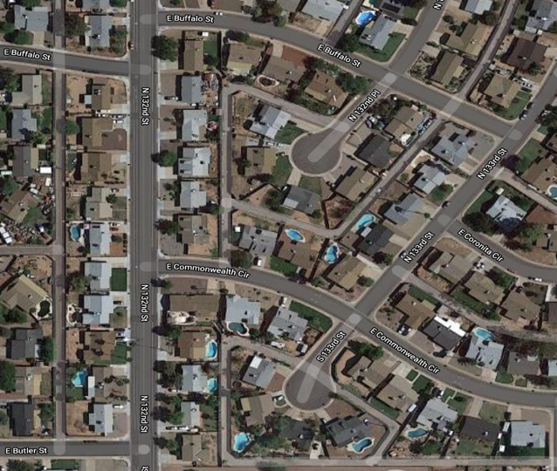
Suspect Residence to Victim Residence

Slide 35
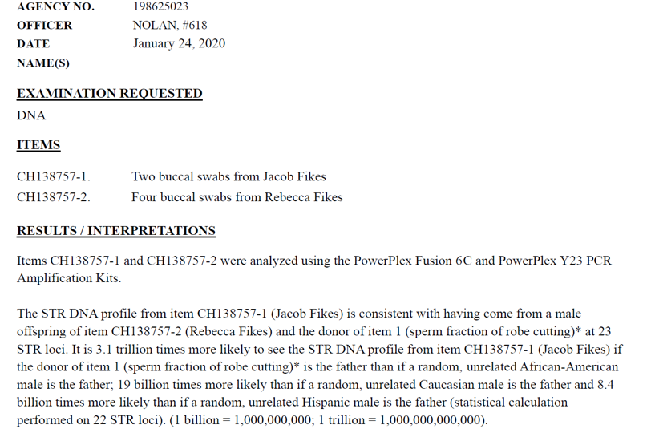

Slide 36
Questions?

Slide 37
Contact Information
Ashley Nolan Cesar Tirado
Detective, SVU SAKI Site Coordinator
Chandler Police Department Maricopa County Attorney’s Office
(480) 782-4495 (602) 506-1581
Ashley.nolan@chandleraz.gov Tiradoc@mcao.maricopa.gov

